Slide 1



Digital Electronics

Slide 2


CHAPTER-5
A/D and D/A converters

Slide 3
5.1: I. Introduction:
Connection between digital devices and sensors is easy compared to connection of any sensor with analog devices. In such cases, the interfacing becomes more tedious.
Conversion between analog to digital and digital to analog becomes important in such cases. The Analog to Digital converter (ADC) converts Analog signals to the Digital Signal, whereas the Digital to Analog converter (DAC) converts Digital signals to the Analog signals.

Slide 4
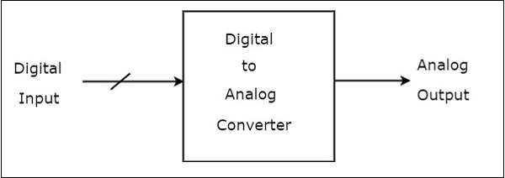
5.2: Digital to Analog Converters:
A Digital to Analog Converter (DAC) converts a digital input signal into an analog output signal.
The digital signal is represented with a binary code, which is a combination of bits 0 and 1.
There are two types of DACs
  Weighted Resistor DAC
  R-2R Ladder DAC
Image source Google

Slide 5
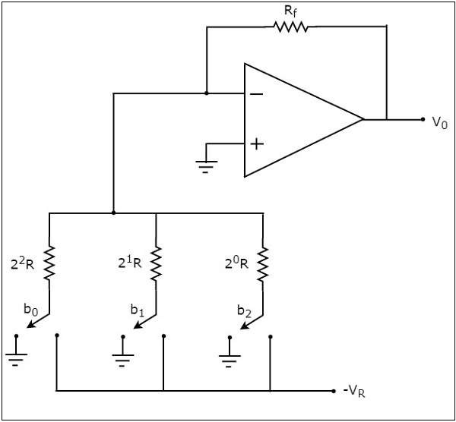
5.2.1: Weighted Resistor Digital to Analog Converter (DAC)
A weighted resistor DAC produces an analog output, which is approximately equal to the digital (binary) input. It uses binary weighted resistors in the inverting adder circuit to accomplish the task.
The circuit diagram of a 3-bit binary weighted resistor DAC is shown here.
Image source Google

Slide 6
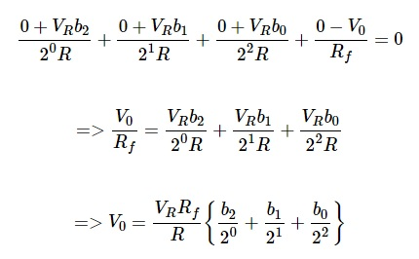
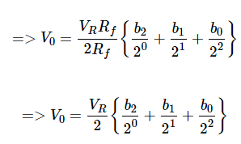

5.2.1: Weighted Resistor Digital to Analog Converter (Continue)
The digital switches will be connected to ground, when the corresponding input bits are equal to ‘0’ whereas they will be connected to the negative reference voltage, −VR when the corresponding input bits are equal to ‘1’.
The nodal equation at the inverting input terminal’s node, simplification and at last the generalized equation of N-bit weighted register DAC is as explained here.
Image source Google

Slide 7
5.2.1: Weighted Resistor Digital to Analog Converter (Continue)
The disadvantages of a binary weighted resistor DAC are as follows :
  It is difficult to design more accurate resistors as the number of bits present in the digital input increases.
  The difference between the resistance values corresponding to LSB & MSB will increase as the number of bits present in the digital input increases.

Slide 8
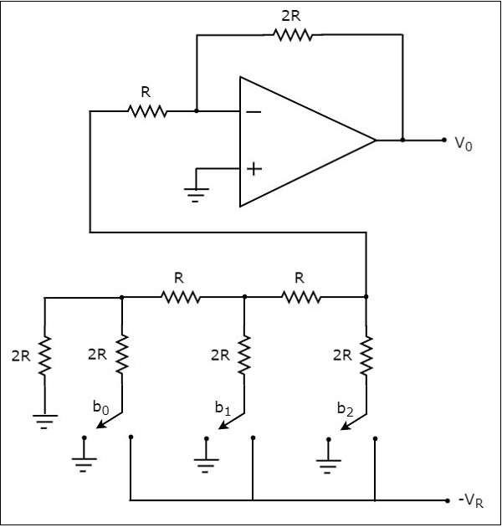
5.2.2: R-2R Ladder DAC
R-2R Ladder DAC produces an analog output, which is almost equal to the digital (binary) input by using a R-2R ladder network in the inverting adder circuit.
The circuit diagram of a 3-bit R-2R Ladder DAC is shown here.
Image source Google

Slide 9
5.2.2: R-2R Ladder DAC (Continue..)
The digital switches shown in the above figure will be connected to ground, when the corresponding input bits are equal to ‘0’.
Similarly, the digital switches shown in above figure will be connected to the negative reference voltage, −VR when the corresponding input bits are equal to ‘1’.
The advantages of R-2R Ladder DAC are as follows −
  R-2R Ladder DAC contains only two values of resistor: R and 2R. So, it is easy to select and design more accurate resistors.
  If more number of bits are present in the digital input, then we have to include required number of R-2R sections additionally.

Slide 10
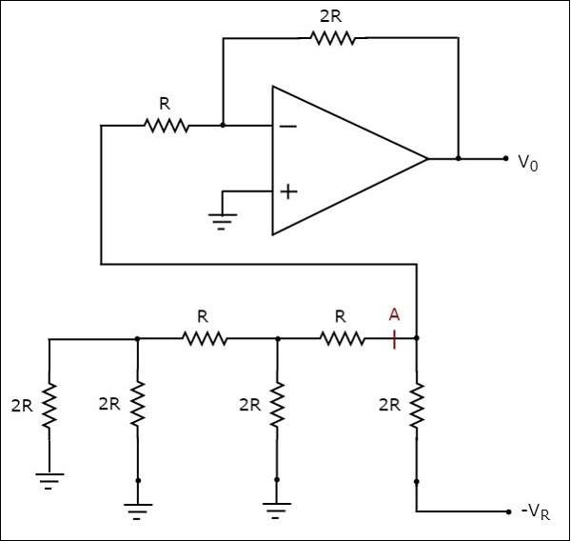
5.2.2: R-2R Ladder DAC (Continue..)
Example
Let us find the value of analog output voltage of R-2R Ladder DAC for a binary input, b₂b₁b₀ = 100.
Image source Google

Slide 11
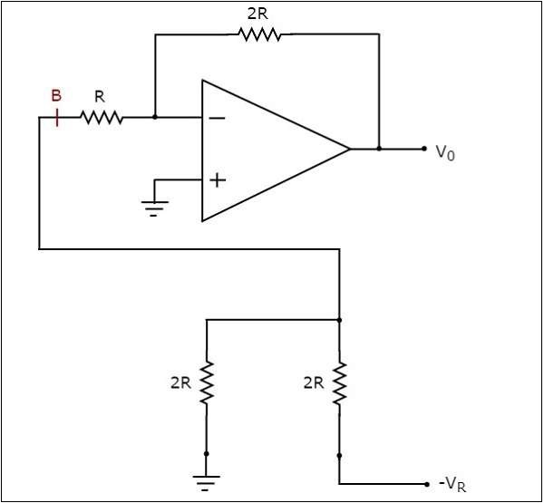
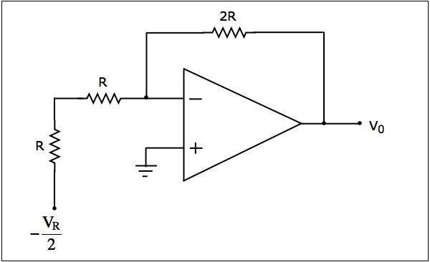
5.2.2: R-2R Ladder DAC (Continue..)
Example (Continue..)
Simplified Diagram➔
Modified Diagram ➔
Image source Google

Slide 12
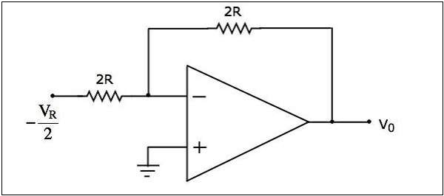
5.2.2: R-2R Ladder DAC (Continue..)
Example (Continue..)
The final diagram looks like an inverting amplifier.
It is having an input voltage of –VR/2 volts, input resistance of 2RΩ and feedback resistance of 2RΩ.
The output voltage of the circuit will be –
Vo=-2R/2R (-VR/2)
Vo=-VR/2
Final Diagram ↓
Image source Google

Slide 13
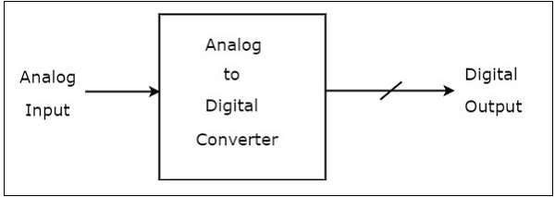
5.3 : Analog to Digital Converter (ADC)
An Analog to Digital Converter (ADC) converts an analog signal into a digital signal.
The number of binary outputs of ADC will be a power of two.
There are two types of ADCs: Direct type ADCs and Indirect type ADC.
Image source Google

Slide 14
5.3.1 : Direct type ADCs
In direct type ADCs, Analog to digital conversion takes place directly by utilizing the internally generated equivalent digital (binary) code for comparing with the analog input.
The following are the examples of Direct type ADCs −
  Counter type ADC
  Successive Approximation ADC
  Flash type ADC

Slide 15
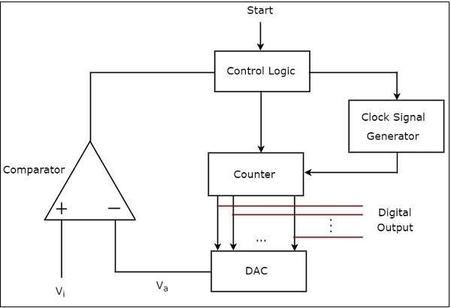
5.3.1.1: Counter type ADC
The counter type ADC mainly consists of 5 blocks: Clock signal generator, Counter, DAC, Comparator and Control logic.
DAC converts the received binary (digital) input, which is the output of counter, into an analog output. Comparator compares this analog value, Va with the external analog input value Vi.
Image source Google

Slide 16
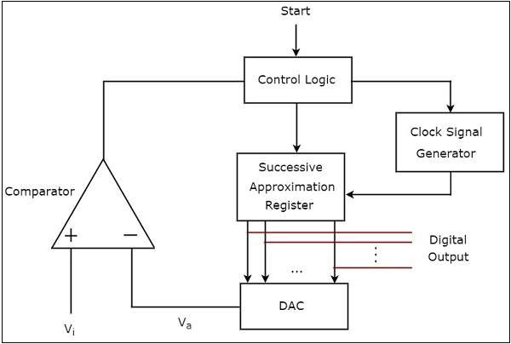
5.3.1.2: Successive Approximation ADC
The counter type ADC mainly consists of 5 blocks: Clock signal generator, Successive Approximation Register (SAR), DAC, Comparator and Control logic.
When circuit received the start signal. The binary data present in SAR will be updated for every clock pulse based on the output of comparator.
The output of SAR is applied as an input of DAC, which is converted into an analog output.
The comparator compares this analog value Va with the external analog input value Vi. The output of a comparator will be ‘1’ as long as Vi is greater than Va and vice versa.
Image source Google

Slide 17
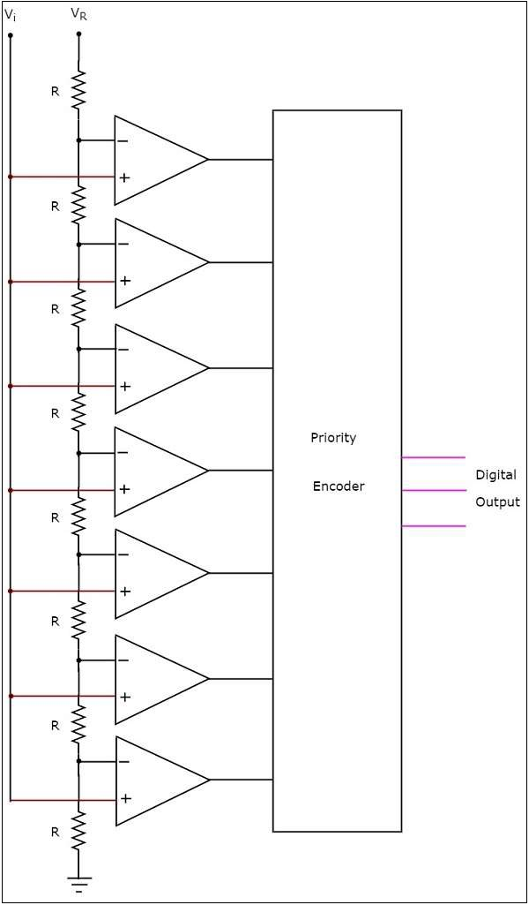
5.3.1.3: Flash type ADC
A flash type ADC produces an equivalent digital output for a corresponding analog input in no time.
Fastest ADC
The circuit diagram of a 3-bit flash type ADC is shown here.
Itconsists of a voltage divider network, 7 comparators and a priority encoder
Image source Google

Slide 18
5.3.1.3: Flash type ADC (Continue..)
The voltage divider network contains 8 equal resistors. A reference voltage VR is applied across that entire network with respect to the ground. The voltage drop across each resistor from bottom to top with respect to ground will be the integer multiples (from 1 to 8) of V_{R}/8.
The external input voltage Vi is applied to the non-inverting terminal of all comparators.
The comparison operations take place by each comparator in a parallel manner.

Slide 19
5.3.1.3: Flash type ADC (Continue..)
All the outputs of comparators are connected as the inputs of priority encoder. This priority encoder produces a binary code (digital output), which is corresponding to the high priority input that has ‘1’.
The output of priority encoder is nothing but the binary equivalent (digital output) of external analog input voltage, Vi.
The flash type ADC is used in the applications where the conversion speed of analog input into digital data should be very high.

Slide 20
5.3.2: Indirect type ADC
If an ADC performs the analog to digital conversion by an indirect method, then it is called an Indirect type ADC.
First it converts the analog input into a linear function of time (or frequency) and then it will produce the digital (binary) output.
Dual slope ADC is the best example of an Indirect type ADC.

Slide 21
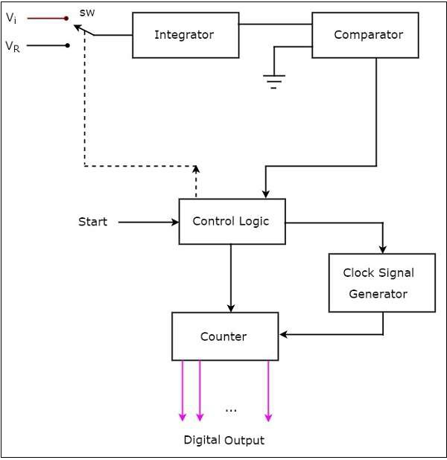
5.3.2.1: Dual Slope ADC
The dual slope ADC mainly consists of 5 blocks: Integrator, Comparator, Clock signal generator, Control logic and Counter.
Control logic pushes the switch sw to connect to the external analog input voltage Vi, when it is received the start commanding signal. This input voltage is applied to an integrator.
Image source Google

Slide 22
5.3.2.1: Dual Slope ADC
The output of the integrator is connected to one of the two inputs of the comparator and the other input of comparator is connected to ground.
Comparator compares the output of the integrator with zero volts (ground) and produces an output, which is applied to the control logic.
The counter gets incremented by one for every clock pulse and its value will be in binary format. It produces an overflow signal to the control logic, when it is incremented after reaching the maximum count value.
This type of ADC is used in the applications, where accuracy is more important.

Slide 23
5.3.4: Examples of A to D converter ICs
Following are the examples of A to D converter ICs
ADC0808
ADC0804

Slide 24
5.3.5: Examples of D to A converter ICs
Following are the examples of D to A converter ICs
DAC7715
DAC8814
DAC8811

Slide 25


www.paruluniversity.ac.in

